Slide 1

Welcome to FreeBSD!
Start

Slide 2
Contents of FreeBSD Presntation
Introduction
Kernal
Process
Memory
Additional Points
FAQ
Introduction to FreeBSD Evolution
Kernal Definition and FreeBSD Facilities
Kernal Organization and Services
Process Management
Memory Management
Additional Points
Questions?

Slide 3





Introduction
Kernal
Process
Memory
Additional Points
FAQ
Introduction
Kernal and services
Process
Memory
Press on the buttons to go for
Needed topics
Additional Points

Slide 4

Kernal
FAQ
Kernal
Memory
Introduction
Memory
Additional Points
Introduction
Process
Process
Additional Points
Introduction
Welcome to the realm of FreeBSD!
In this section, we offer a detailed look at what FreeBSD is, its beginnings, objectives, practical applications, and the community supporting it.

Slide 5

Kernal
FAQ
Kernal
Memory
Introduction
Memory
Additional Points
Introduction
Process
Process
Additional Points
Introduction
FreeBSD is a free and open-source operating system like Unix.
It works on different types of computers, offering various useful features that modern systems usually have.
These features include doing many things at once, protecting memory, allowing many people to use the computer at the same time, supporting different types of hardware, providing tools for software development in many languages, and offering desktop features using systems like X Window, KDE, or GNOME.

Slide 6
Kernal
FAQ
Kernal
Memory
Introduction
Memory
Additional Points
Introduction
Process
Process
Additional Points
Why is it called FreeBSD?
The name "FreeBSD" comes from its connection to the Berkeley Software Distribution (BSD) UNIX operating system, which has a significant impact on open-source software. The term "Free" in FreeBSD represents its dedication to free and open-source software principles, allowing users the freedom to study, change, and share the code.
It is worth pointing out that the word "free" is being used in two ways here: one meaning "at no cost" and the other meaning "do whatever you like".

Slide 7
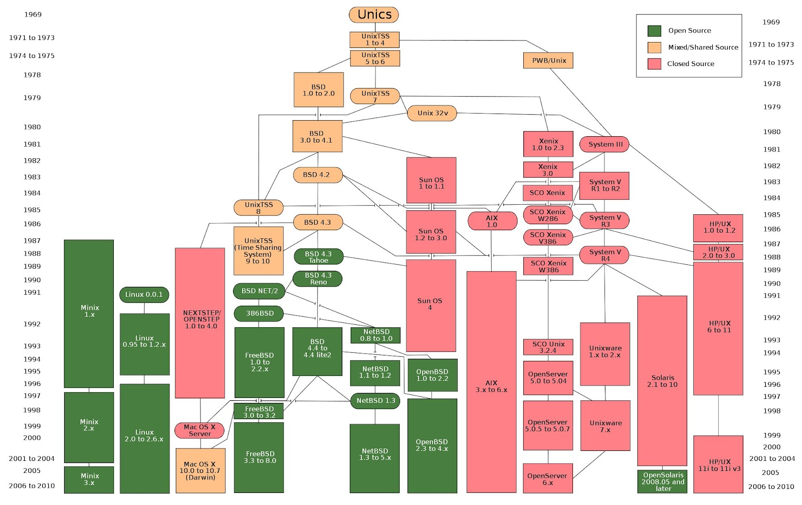
Introduction
Evolution
Process
Memory
Security
FAQ
Introduction
FreeBSD is a free and open-source operating system like Unix. It works on different types of computers, offering various useful features that modern systems usually have. These features include doing many things at once, protecting memory, allowing many people to use the computer at the same time, supporting different types of hardware, providing tools for software development in many languages, and offering desktop features using systems like X Window, KDE, or GNOME.

Slide 8
Kernal
FAQ
Kernal
Memory
Introduction
Memory
Additional Points
Introduction
Process
Process
Additional Points
What Can FreeBSD Do?
FreeBSD is a flexible system used for many things, from software development to controlling machinery and adjusting satellite antennas. It's free and can be customized a lot.
Internet Services: It's good for web, email, and storage servers.
Education: Great for learning about computers and software.
Research: Helps study computers and collaborate on projects.
Networking: Turns an old computer into a router or firewall.
Embedded Systems: Useful for making small devices like routers.
Desktop Use: Works for basic computer use and can be set up cheaply.
Software Development: Comes with tools for making software in different languages.

Slide 9
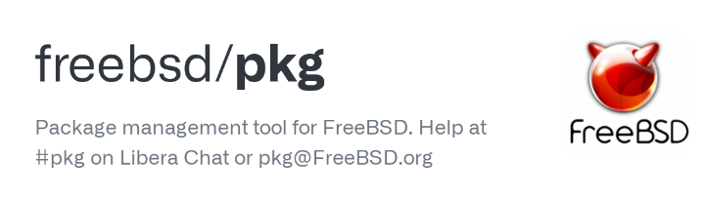
Kernal
FAQ
Kernal
Memory
Introduction
Memory
Additional Points
Introduction
Process
Process
Additional Points
What makes FreeBSD Interesting?
FreeBSD has a collection of 36,000 software programs called "ports." You can easily install these by typing a simple command. They offer a range of tools from games to webservers. You can either build them yourself or get them as pre-made "packages" by using another simple command. This saves you from building the software from its source code. This is called Third Party Programs
Press here to learn how to download apps
Press here to understand it

Slide 10

Kernal
FAQ
Kernal
Memory
Introduction
Memory
Additional Points
Introduction
Process
Process
Additional Points
Third-Party Programs
Third-party programs are like extra tools made by different people or companies, not the main creators of the system.
These tools add more functions or features that the main system doesn't have.
For example, they can be apps, games, or other helpful software that you can use on your computer, phone, or any system to do specific things.
Back again

Slide 11
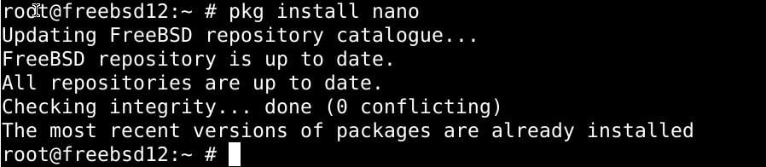
Kernal
FAQ
Kernal
Memory
Introduction
Memory
Additional Points
Introduction
Process
Process
Additional Points
Use of PKG in FreeBSD
In FreeBSD, the "pkg" tool is used for managing software packages. It allows users to install, update, or remove pre-compiled software packages from the system. By utilizing the "pkg" command, users can easily handle the installation and maintenance of various software applications without having to compile them from their source code. This simplifies the process and makes it more efficient to manage and update software on a FreeBSD system.
The pkg command first appeared in FreeBSD 9.1. It became the default package tool in FreeBSD 10.0,
replacing the pkg_install suite of tools pkg_add(1), pkg_info(1), and pkg_create(1).
Back again

Slide 12
Kernal
FAQ
Kernal
Memory
Introduction
Memory
Additional Points
Introduction
Process
Process
Additional Points
FreeBSD Facilities and the Kernel
The Kernel
The Kernel is part of the system that runs in protected mode and is responsible for managing hardware resources and providing fundamental services to other software components by managing processes and providing functions called system calls to access the filesystem and communication facilities.

Slide 13
Kernal
FAQ
Kernal
Memory
Introduction
Memory
Additional Points
Introduction
Process
Process
Additional Points
FreeBSD Facilities and the Kernel
Difference between UNIX & FreeBSD Kernel
Unlike the earliest versions of UNIX, the FreeBSD Kernel is not partitioned into multiple processes. The monolithic kernel was chosen for simplicity and performance.
Users mostly interact with the system through a CLI called a Shell, and through additional user application programs. Both are implemented with processes rather than being part of the Kernel.

Slide 14
Kernal
FAQ
Kernal
Memory
Introduction
Memory
Additional Points
Introduction
Process
Process
Additional Points
FreeBSD Facilities and the Kernel
FreeBSD Kernal provides four basic facilities
Processes
Filesystems
Communications
System startup
Press Here
Press Here
Press Here
Press Here

Slide 15
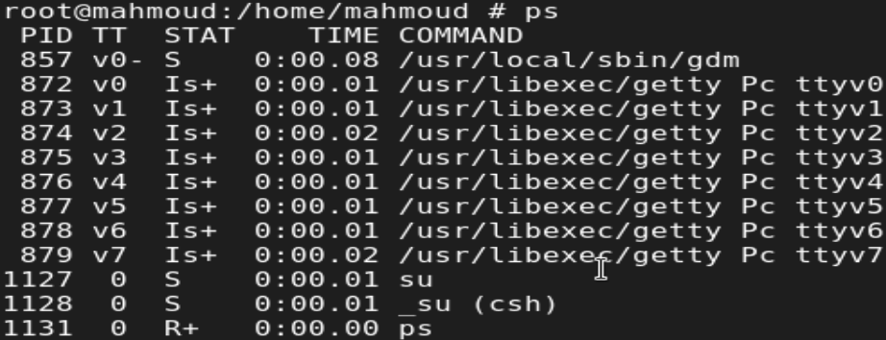
Kernal
FAQ
Kernal
Memory
Introduction
Memory
Additional Points
Introduction
Process
Process
Additional Points
Composed of an address space with one or more threads of control running within it.
The system multiplexes separate virtual-address spaces for each process.
Processes
To show process States, use (PS) command to show it
Back

Slide 16
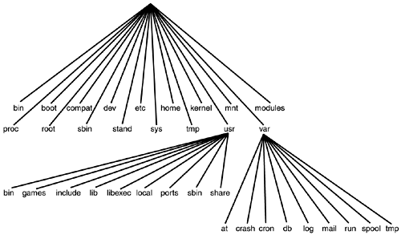
Kernal
FAQ
Kernal
Memory
Introduction
Memory
Additional Points
Introduction
Process
Process
Additional Points
The filesystem provides operations to manipulate a set of named files, organized in a tree-structured hierarchy of directories. The filesystem organizes the files and directories on physical media, such as disks.
Filesystem
Back

Slide 17
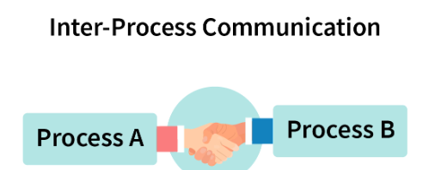
Kernal
FAQ
Kernal
Memory
Introduction
Memory
Additional Points
Introduction
Process
Process
Additional Points
Provided by the traditional UNIX system, it offers a variety of communication methods like: Inter-process communication, networking, and serial communication. The specific communication method used depends on the application.
Communications
Back

Slide 18
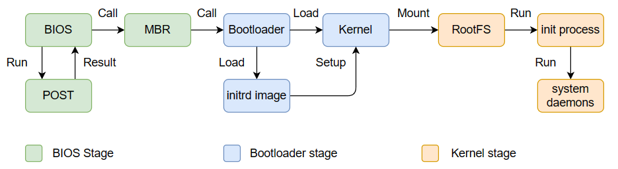
Kernal
FAQ
Kernal
Memory
Introduction
Memory
Additional Points
Introduction
Process
Process
Additional Points
Complex series of events that culminate in the loading and execution of the OS Kernel. It can be broadly divided into three stages: Bootstrapping → Bootloader → Kernel Initialization
System Startup
Back

Slide 19
Kernal
FAQ
Kernal
Memory
Introduction
Memory
Additional Points
Introduction
Process
Process
Additional Points
Kernel Organization in FreeBSD
FreeBSD Organize Kernal based on 2 ways
1. As a static body of software, categorized by the functionality offered by the modules that make up the kernel.
2. By its dynamic operation, categorized according to the services provided to users.

Slide 20
Kernal
FAQ
Kernal
Memory
Introduction
Memory
Additional Points
Introduction
Process
Process
Additional Points
Kernel Organization in FreeBSD
The FreeBSD kernel, at its core, manages hardware and serves as a platform
for applications. It is organized into several key components:
Basic Kernel Facilities: This includes managing timers, system clocks, descriptors, and processes.
Security Features: Encompassing conventional UNIX security models, as well as additional features like sandboxing, virtualization, event auditing, and cryptographic services.
Memory Management Support: Involving paging and swapping.
Generic System Interfaces: Handling I/O, control, and multiplexing operations on descriptors.
Filesystems: Managing files, directories, pathname translation, file locking, and I/O buffer.
Terminal Handling Support: Covering pseudo-terminal interface and terminal line disciplines.
Interprocess-Communication Facilities: Primarily, sockets.
Network Communication Support: Involving communication protocols and generic network facilities like routing.

Slide 21
Kernal
FAQ
Kernal
Memory
Introduction
Memory
Additional Points
Introduction
Process
Process
Additional Points
Kernel Organization in FreeBSD
The kernel, being the OS core, must be adaptable to various hardware architectures. To achieve this, machine-dependent aspects are separated, including:
Low-Level System Startup Actions: Initializing the CPU, setting up the memory management unit,
and configuring the interrupt controller.
Trap and Fault Handling: Managing errors such as divide-by-zero, page faults, and illegal instructions.
Process Run-Time Context Manipulation: Involving switching between processes, saving and restoring process state, and managing process memory.
Configuration and Initialization of Hardware Devices: Includes configuring device drivers, setting up DMA channels, and allocating IRQs.
Run-Time Support for I/O Devices: Handling I/O requests, managing buffers, and transferring data between devices.

Slide 22
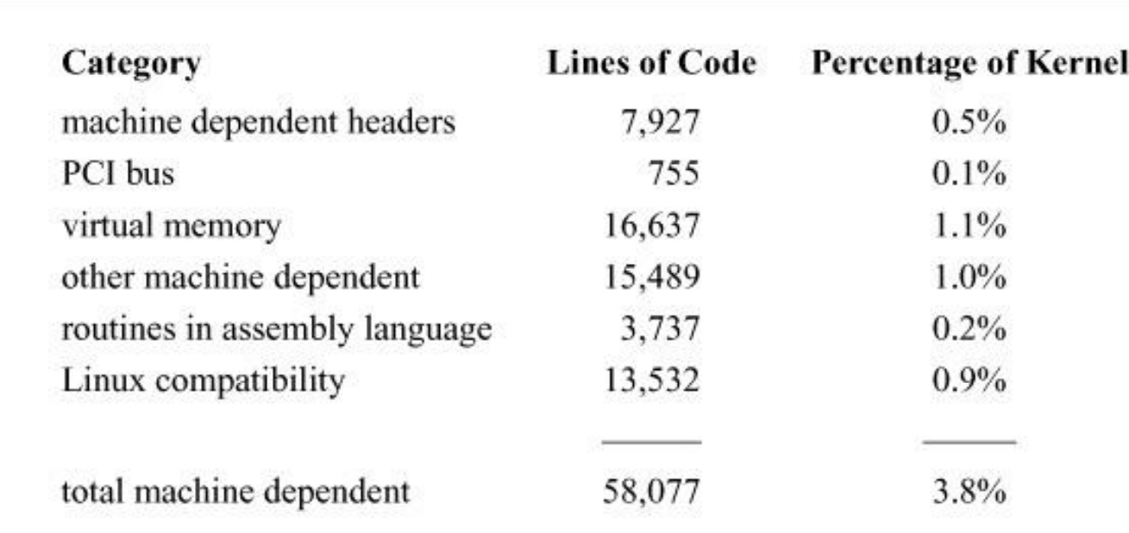
Kernal
FAQ
Kernal
Memory
Introduction
Memory
Additional Points
Introduction
Process
Process
Additional Points
Kernel Organization in FreeBSD
By isolating these machine-dependent aspects of the kernel, the kernel can be made more portable and easier to maintain. This is especially important for operating systems that are designed to run on a variety of hardware platforms.

Slide 24
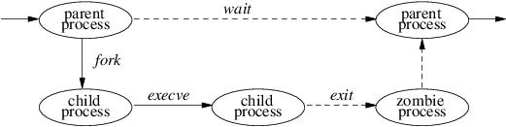
Kernal
FAQ
Kernal
Memory
Introduction
Memory
Additional Points
Introduction
Process
Process
Additional Points
Process
What is process management ?
Process management refers to the set of activities involved in creating, scheduling, and terminating processes.
A process management OS can be thought of as an instance of a program that is currently executing on a computer system

Slide 25
Kernal
FAQ
Kernal
Memory
Introduction
Memory
Additional Points
Introduction
Process
Process
Additional Points
Process
As we know from the Operating Systems Evolution tree,
Almost all the OS’s existed now is based on UNIX in 1965
At that time there were only 2 processes, Passing by all the editions to the PDP up to PDP-11
all these systems were only allowed one process at a time in memory.
When a PDP-11 with memory management was obtained (KS-11)
The system was changed to execute several processes to remain in memory together to reduce swapping.
But this change did not apply to multiprogramming
because disk I/O was synchronous.
What’s PDP-11?

Slide 26
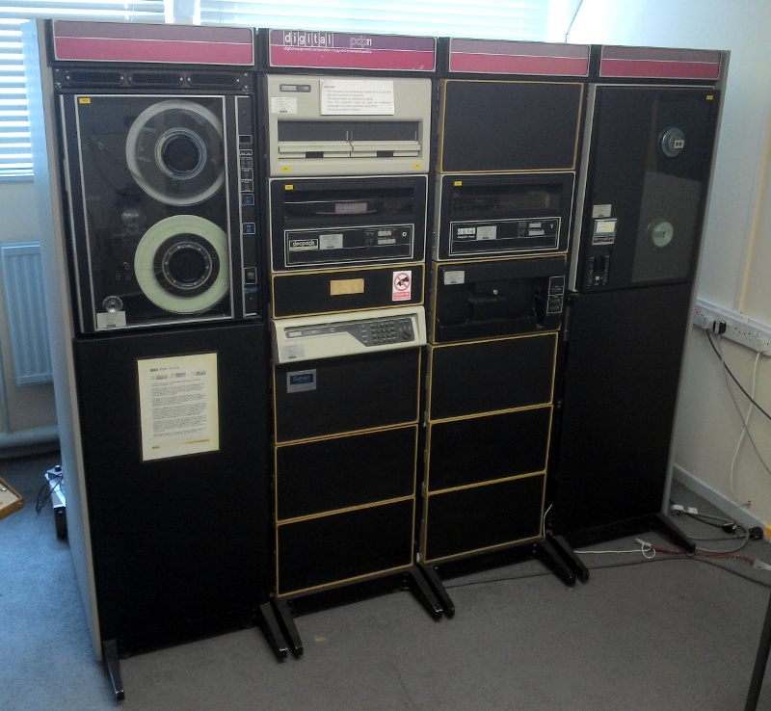
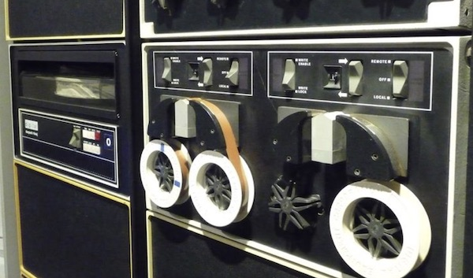
Kernal
FAQ
Kernal
Memory
Introduction
Memory
Additional Points
Introduction
Process
Process
Additional Points
PDP-11 (Programmed Data Processor) : a series of 16-bit minicomputers sold from 1970 into the late 1990s, one of a set of products in the Programmed Data Processor (PDP) series.
Back Again

Slide 27
Kernal
FAQ
Kernal
Memory
Introduction
Memory
Additional Points
Introduction
Process
Process
Additional Points
Process
FreeBSD can make it seem like many programs are running at the same time, and it does this by switching between different tasks (Context switching). This switching happens in these situations
1. When a more important task becomes ready to run.
2. When there's an interruption, like handling an external event.
3. When the computer shifts between regular user work and system-level work (though not always).
4. When the computer uses a method that can stop a task and switch to another one, which is called preemptive scheduling.

Slide 28
Kernal
FAQ
Kernal
Memory
Introduction
Memory
Additional Points
Introduction
Process
Process
Additional Points
Process
In FreeBSD’s default scheduler, which referred to as timeshare scheduler, a process’s priority is continuously recalculated based on various parameters, such as the amount of CPU time it has used, the amount of memory resources it holds or requires for execution.
In Addition, it implements a real-time scheduling using a separate queue from the queue used for regular timeshared processes
So, after searching in many reference, based on The Design and Implementation of the FreeBSD Operating System Book, we found the FreeBSD Scheduling algorithm use
Multi-Level Feedback Queue (MLFQ)
How Does it work?

Slide 29
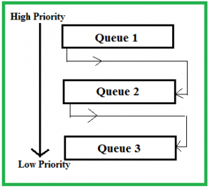
Kernal
FAQ
Kernal
Memory
Introduction
Memory
Additional Points
Introduction
Process
Process
Additional Points
Multilevel Feedback Queue (MLFQ) scheduling is like a smart way of managing computer tasks. In the regular way (Multilevel Queue), tasks are put into different groups when they start, and they stay there. But in MLFQ, tasks can move between these groups based on how they behave.
This helps make things work better because it adjusts the importance of tasks while the computer is running.
MLFQ has a few cool features: it uses different groups for tasks, changes their importance as needed, divides time fairly between them, learns from how tasks are doing, and can switch between tasks when necessary.
Popular 3 queues applied in general MLFQ are RR, RR and FCFS
Back Again

Slide 30
Kernal
FAQ
Kernal
Memory
Introduction
Memory
Additional Points
Introduction
Process
Process
Additional Points
Memory
What’s Main Memory?
Think of a computer's main memory like a big storage area for information.
It's like a massive collection of words or bytes, ranging from lots to loads.
This memory is super fast and helps the computer's brain (the CPU) talk quickly with other parts like devices.
Main memory is where programs and data hang out when the computer is using them.
In a busy computer that can do many things at once (multiprogramming), a chunk of this memory is set aside for the boss (the Operating System), and the rest is shared by different tasks. Splitting and organizing this memory for various jobs is called Memory Management.

Slide 31
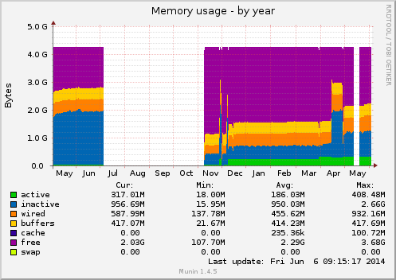
Kernal
FAQ
Kernal
Memory
Introduction
Memory
Additional Points
Introduction
Process
Process
Additional Points
Memory
From FreeBSD Point of view
For FreeBSD, which is like a type of computer language, it follows a similar idea. In FreeBSD, the main memory is important for holding and sorting information for different tasks. The boss (Operating System) has its space, and the rest is smartly used for various jobs, making sure everything runs smoothly.
Virtual Memory
Page System
Memory Allocation
Swap Space
Used Algorithm For VM Algorithm

Slide 32
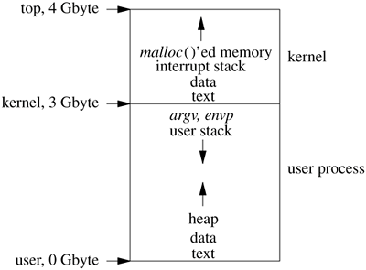
Kernal
FAQ
Kernal
Memory
Introduction
Memory
Additional Points
Introduction
Process
Process
Additional Points
Virtual Memory
Virtual memory in FreeBSD lets each job have its own separate space for addresses, even if they share the same physical memory. This clever setup allows for smooth multitasking, making it seem like each job has its own special memory area.
Using virtual memory makes the system more stable and flexible, giving the impression that there's more memory available than there actually is.
Back

Slide 33
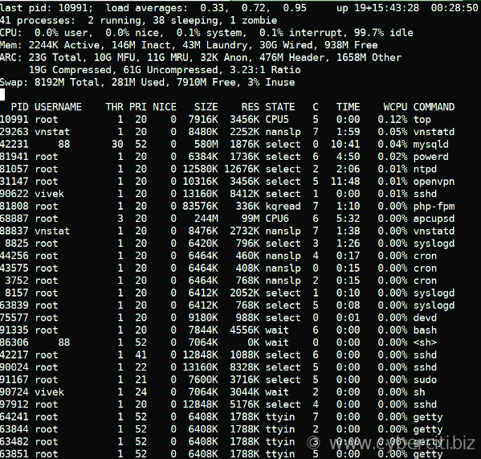
Kernal
FAQ
Kernal
Memory
Introduction
Memory
Additional Points
Introduction
Process
Process
Additional Points
Page System
The page system in FreeBSD breaks down the computer's memory into fixed-size chunk
usually, 4 KB each. This method helps manage memory effectively by letting the operating system handle memory in smaller, more manageable portions.
The page system is vital for making sure memory is used well and for efficiently moving data between the computer's RAM and the hard drive.
Back

Slide 34
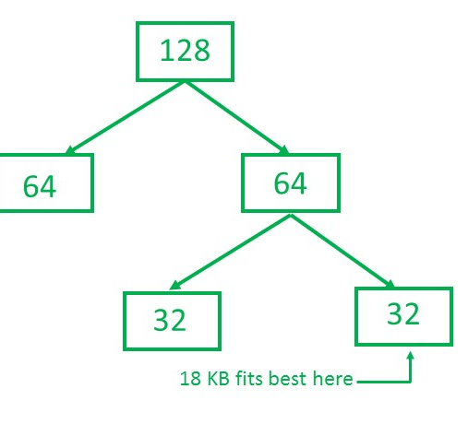
Kernal
FAQ
Kernal
Memory
Introduction
Memory
Additional Points
Introduction
Process
Process
Additional Points
Memory Allocation
FreeBSD uses different strategies for handing out memory, and one interesting approach is the buddy system. This system organizes memory blocks of different sizes, adjusting them as needed for running jobs. This dynamic memory allocation makes sure resources are used efficiently and adapts to the changing needs of active tasks.
Back

Slide 35
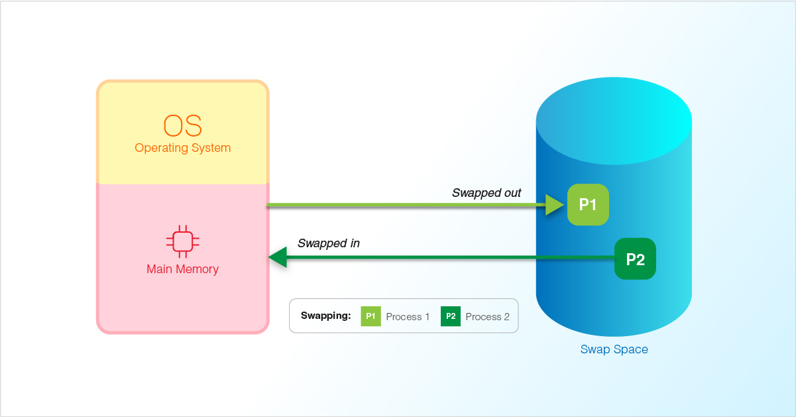
Kernal
FAQ
Kernal
Memory
Introduction
Memory
Additional Points
Introduction
Process
Process
Additional Points
Swap Space
Swap space is like a special area on the hard drive that FreeBSD uses when there's not enough physical memory for what the system is doing. It acts as a temporary storage space for data that's not actively in use, helping the system keep going smoothly.
Swap space stops the system from crashing when there's not enough regular memory and gives a way to handle extra memory needs gracefully.
Back

Slide 36
Kernal
FAQ
Kernal
Memory
Introduction
Memory
Additional Points
Introduction
Process
Process
Additional Points
LRU
LRUL:RURRLRURUR
LRUL:RURRLRURUR
LRUL:RURRLRURUR
LRUL:RURRLRURUR
LRUL:RURRLRURUR
LRUL:RURRLRURUR
LRUL:RURRLRURUR
LRUL:RURRLRURUR
LRUL:RURRLRURUR
LRUL:RURRLRURUR
LRUL:RURRLRURUR
LRUL:RURRLRURUR
LRUL:RURRLRURUR
LRUL:RURRLRURUR
LRUL:RURRLRURUR
LRUL:RURRLRURUR
LRUL:RURRLRURUR
LRUL:RURRLRURUR
LRUL:RURRLRURUR
LRUL:RURRLRURUR
LRUL:RURRLRURUR
LRUL:RURRLRURUR
LRUL:RURRLRURUR
LRUL:RURRLRURUR
Back

Slide 37
Kernal
FAQ
Kernal
Memory
Introduction
Memory
Additional Points
Introduction
Process
Process
Additional Points
Additional Points
Welcome to the realm of FreeBSD!
In this section, we offer a detailed look at what FreeBSD is, its beginnings, objectives, practical applications, and the community supporting it.

Slide 38
Kernal
FAQ
Kernal
Memory
Introduction
Memory
Additional Points
Introduction
Process
Process
Additional Points
FAQ
Welcome to the realm of FreeBSD!
In this section, we offer a detailed look at what FreeBSD is, its beginnings, objectives, practical applications, and the community supporting it.

Slide 39
Introduction
Kernal
Process
Memory
Security
Additional Points
Insert the solution here
Insert the solution here
Insert the solution here

Slide 40

Desktop Software
Introduction
Kernal
Process
Memory
Security
Additional Points
You can change the image on the screen with your own work. Just delete this one, add yours and send it to the back

Slide 41
Homework Upload
Watch this documentary and write an essay on it
Jupiter is the biggest planet in the Solar System
1
Despite being red, Mars is actually a cold place
2
Mercury is the smallest planet in the Solar System
3

Slide 42
Thanks!
Do you have any questions?
youremail@freepik.com
+91 620 421 838
yourcompany.com

